Slide 1
Homophily and modularity

Slide 2
What Is Homophily?
Homophily is the principle that individuals tend to associate and bond with similar others. Typically, people form friendships, acquaintances, business relations, and other ties based on similarity in age, language, education, occupation, interests, opinions, etc. In this context, homophily is also called assortative mixing. This tendency is also seen in some non-social networks.
More rarely, one also encounters disassortative mixing: the tendency for people to associate with others who are unlike them.
We look at how the level of homophily in networks can be measured.

Slide 3
Long History
Plato: “Similarity begets friendship.”
Aristotle: People “loves those who are like themselves.”
Proverb: “Birds of a feather flock together.”

Slide 4
Colored Graphs
Suppose we have a network in which the nodes are classified according to some characteristic that has a finite set of possible values. For instance, the nodes could represent people classified according to their nationality. Or they could be web pages classified by what language they are written in.
We can identify such a network with a colored graph where each vertex is colored with a color from a fixed set of colors.

Slide 5
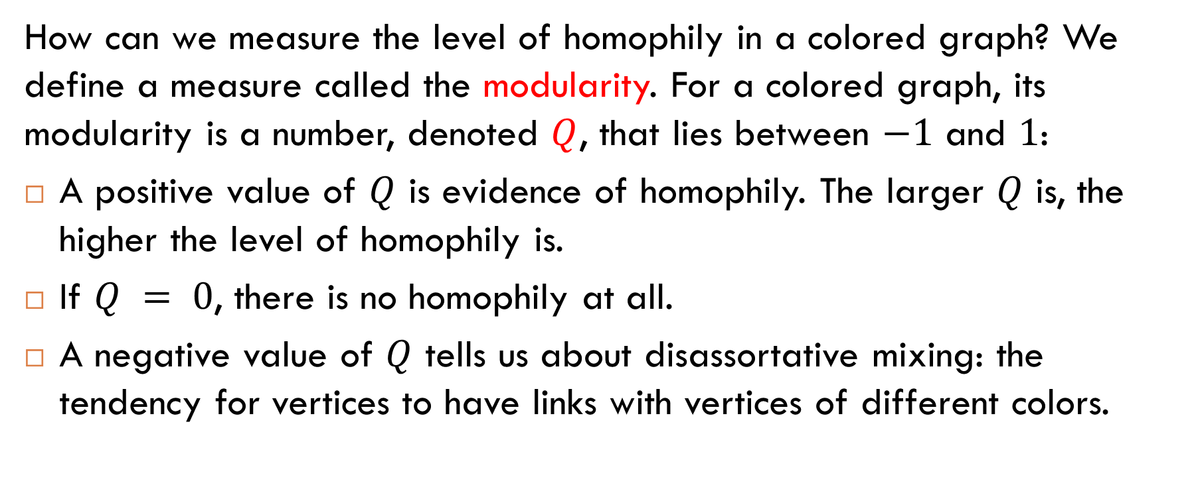
Modularity
How can we measure the level of homophily in a colored graph? We define a measure called the modularity. For a colored graph, its modularity is a number, denoted $Q$, that lies between $−1$ and $1$:
A positive value of $Q$ is evidence of homophily. The larger $Q$ is, the higher the level of homophily is.
If $Q = 0$, there is no homophily at all.
A negative value of $Q$ tells us about disassortative mixing: the tendency for vertices to have links with vertices of different colors.

Slide 6
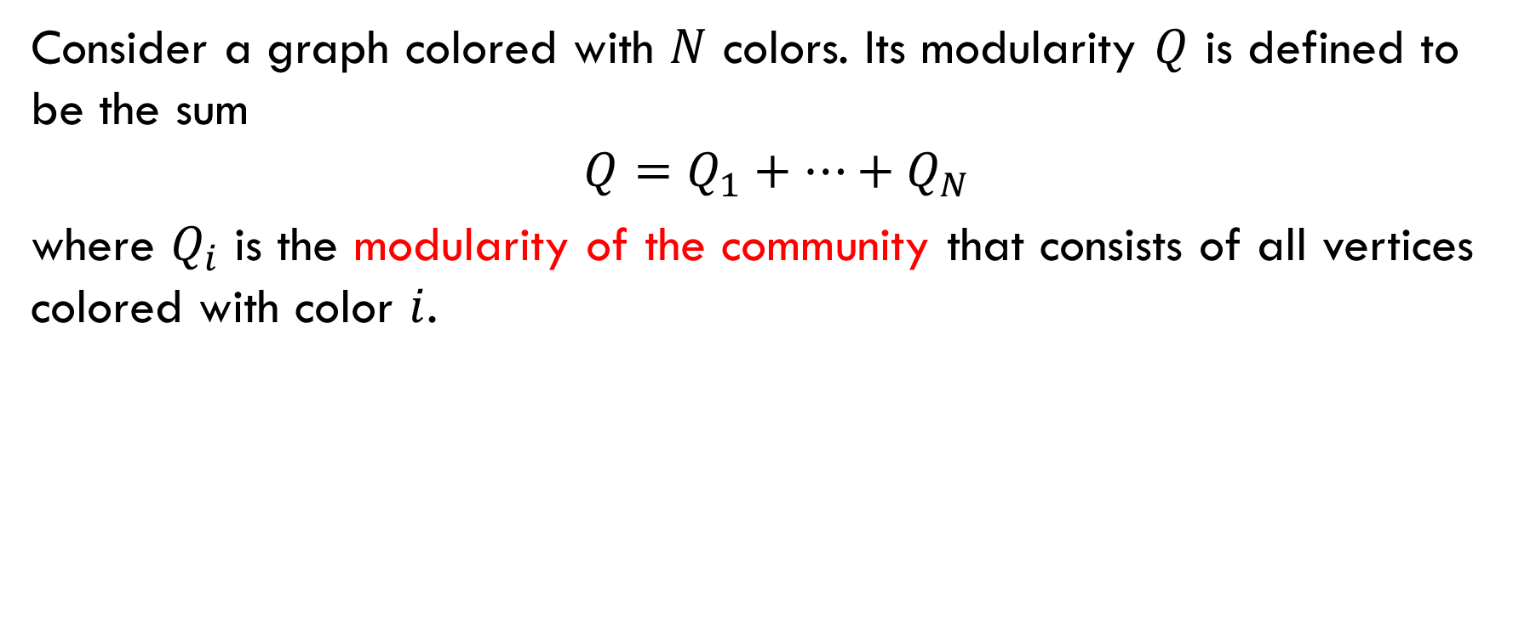
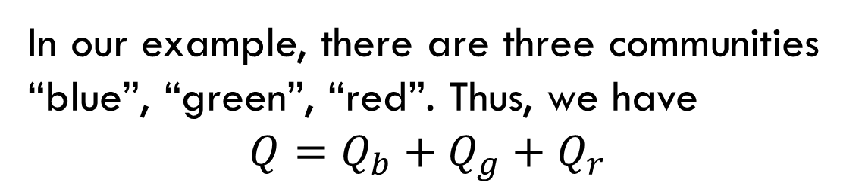
Definition of Modularity: Step 1
Consider a graph colored with $N$ colors. Its modularity $Q$ is defined to be the sum
$$Q=Q_{1}+…+Q_{N}$$
where $Q_{i}$ is the modularity of the community that consists of all vertices colored with color $i$.
In our example, there are three communities “blue”, “green”, “red”. Thus, we have
$$Q=Q_{b}+Q_{g}+Q_{r}$$

Slide 7
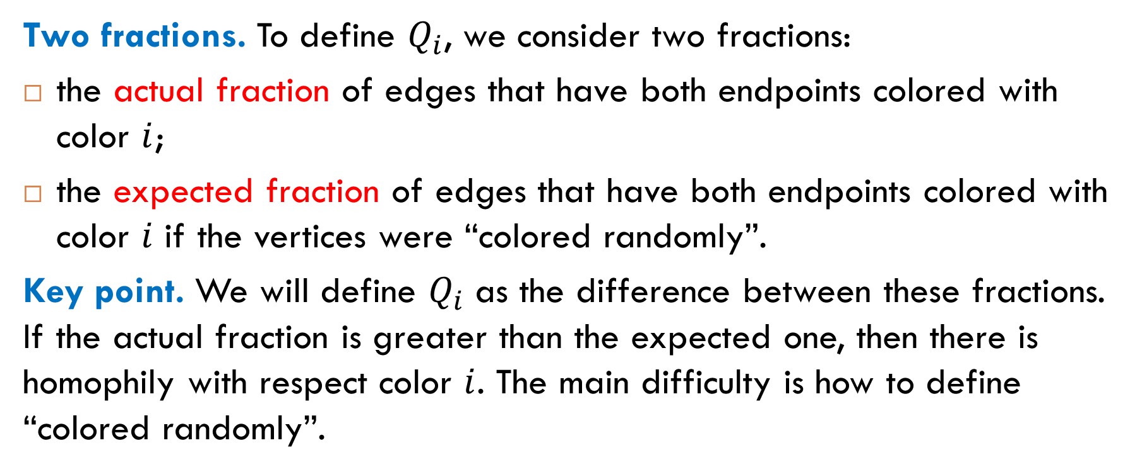
Modularity of Community: Idea
Two fractions. To define $Q_{i}$, we consider two fractions:
the actual fraction of edges that have both endpoints colored with color $i$;
the expected fraction of edges that have both endpoints colored with color $i$ if the vertices were “colored randomly”.
Key point. We will define $Q_{i}$ as the difference between these fractions. If the actual fraction is greater than the expected one, then there is homophily with respect color $i$. The main difficulty is how to define “colored randomly”.

Slide 8
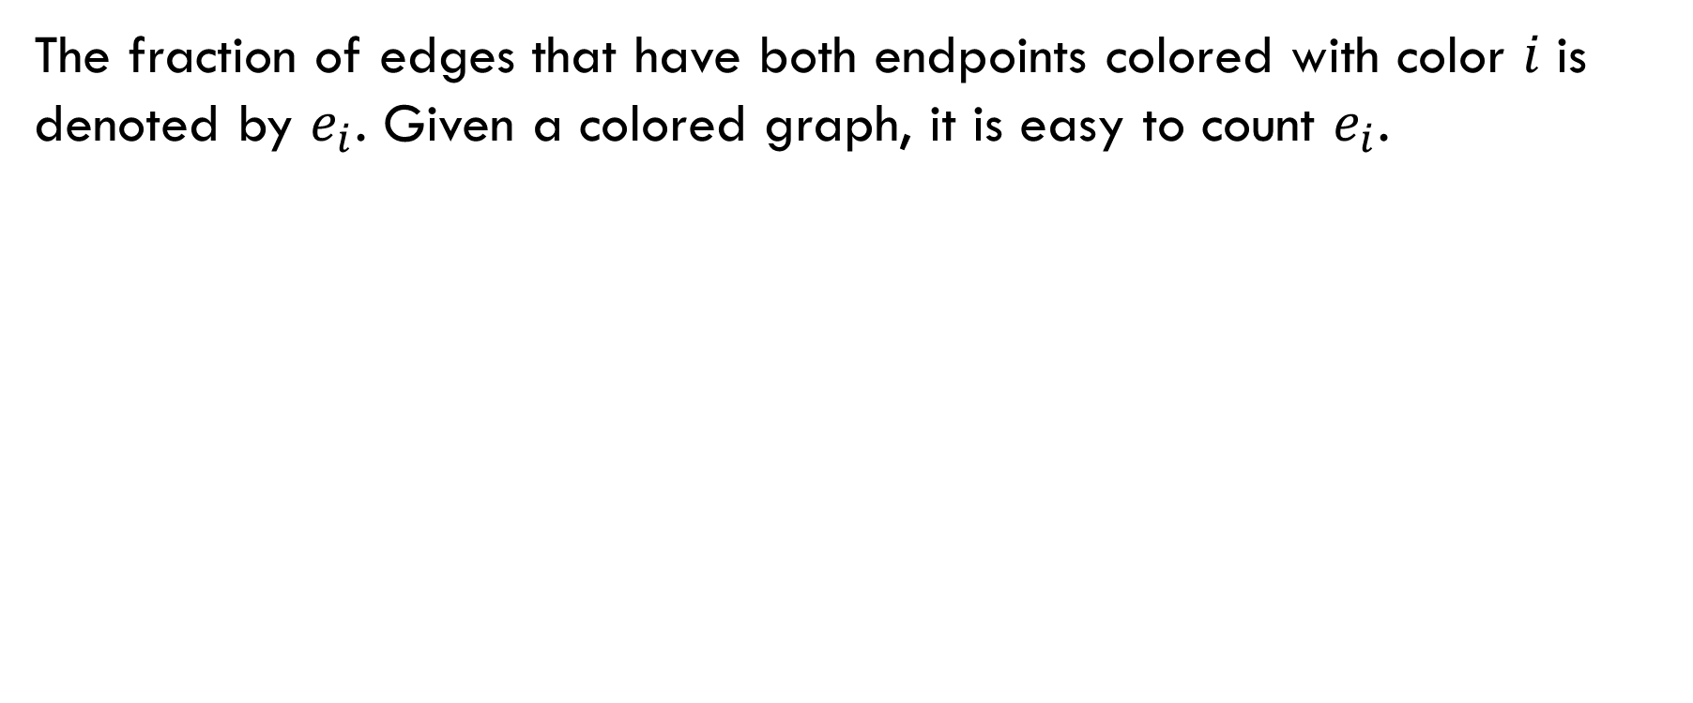
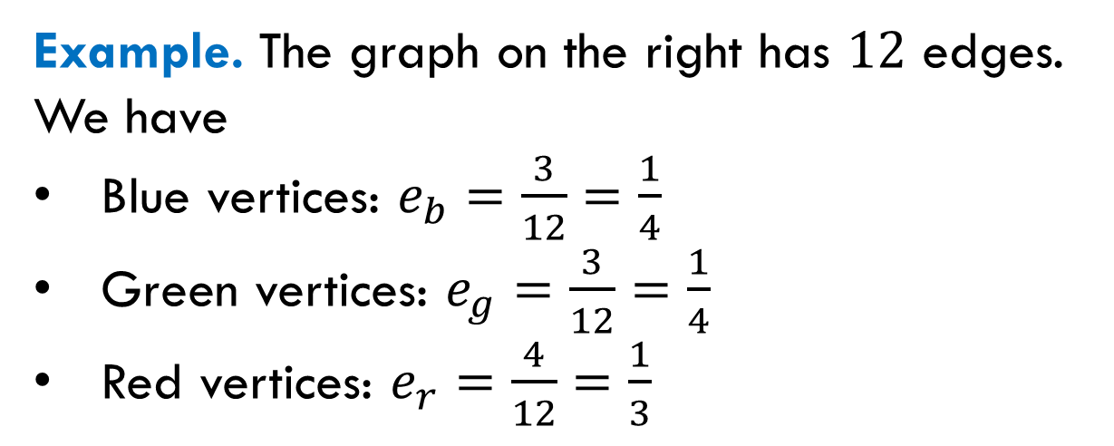
Actual Fraction
The fraction of edges that have both endpoints colored with color 𝑖 is denoted by $e_{i}$. Given a colored graph, it is easy to count $e_{i}$.
Example. The graph on the right has $12$ edges. We have
Blue vertices: $e_{b}=\frac{3}{12}=\frac{1}{4}$
Green vertices: $e_{g}=\frac{3}{12}=\frac{1}{4}$
Red vertices: $e_{r}=\frac{4}{12}=\frac{1}{3}$

Slide 9
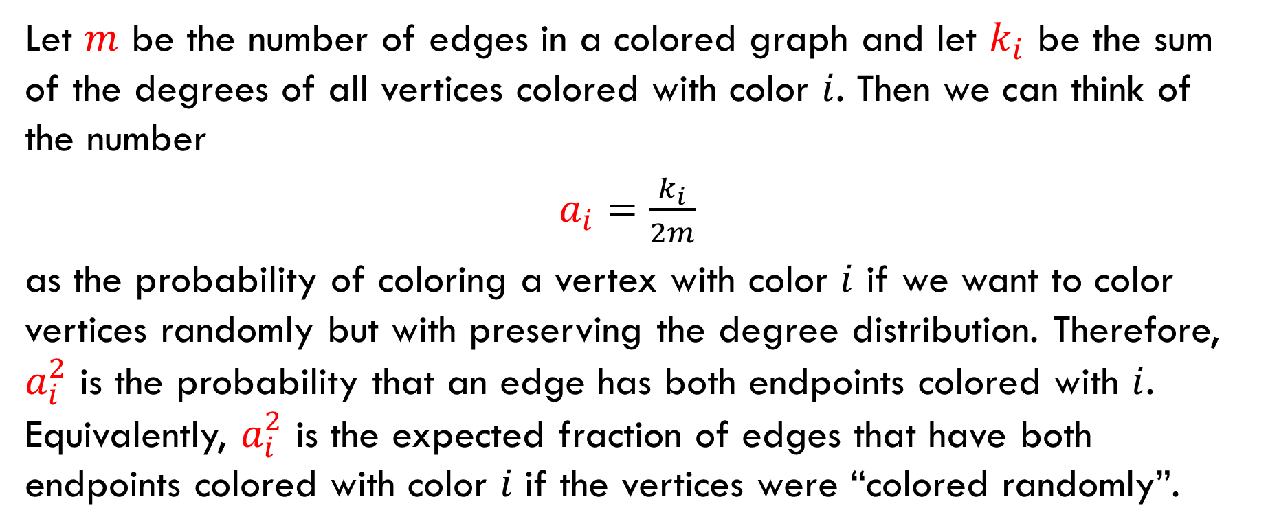
Expected Fraction
Let $m$ be the number of edges in a colored graph and let $k_{i}$ be the sum of the degrees of all vertices colored with color $i$. Then we can think of the number
$a_{i}=\frac{k_{i}}{2m}$
as the probability of coloring a vertex with color $i$ if we want to color vertices randomly but with preserving the degree distribution. Therefore, $a_{i}^{2}$ is the probability that an edge has both endpoints colored with $i$. Equivalently, $a_{i}^{2}$ is the expected fraction of edges that have both endpoints colored with color 𝑖 if the vertices were “colored randomly”.

Slide 10
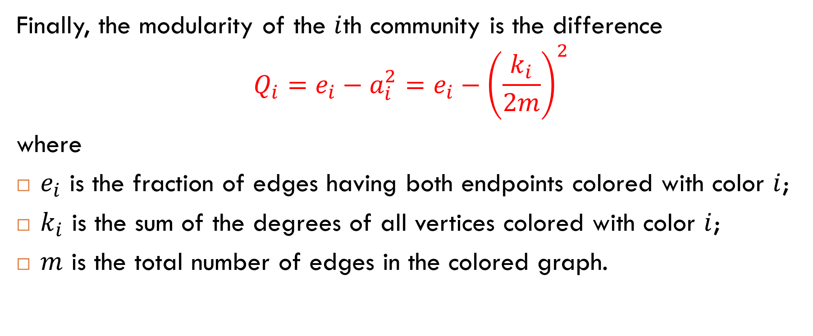
Definition of Modularity: Step 2
Finally, the modularity of the $i$th community is the difference
$$Q_{i}=e_{i}−a_{i}^{2}=e_{i}−{\left(\frac{k_{i}}{2m}\right)}^{2}$$
where
$e_{i}$ is the fraction of edges having both endpoints colored with color $i$;
$k_{i}$ is the sum of the degrees of all vertices colored with color $i$;
$m$ is the total number of edges in the colored graph.

Slide 11
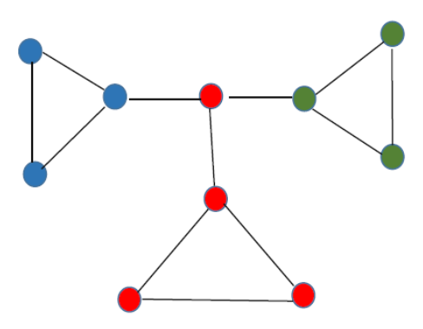
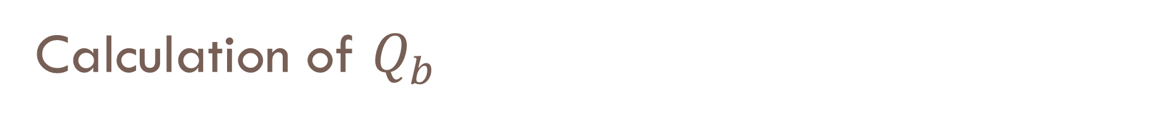
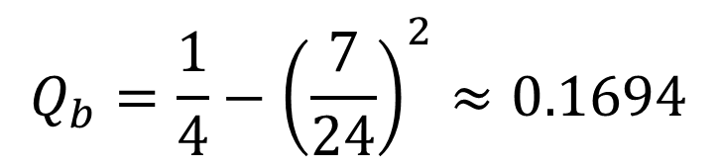
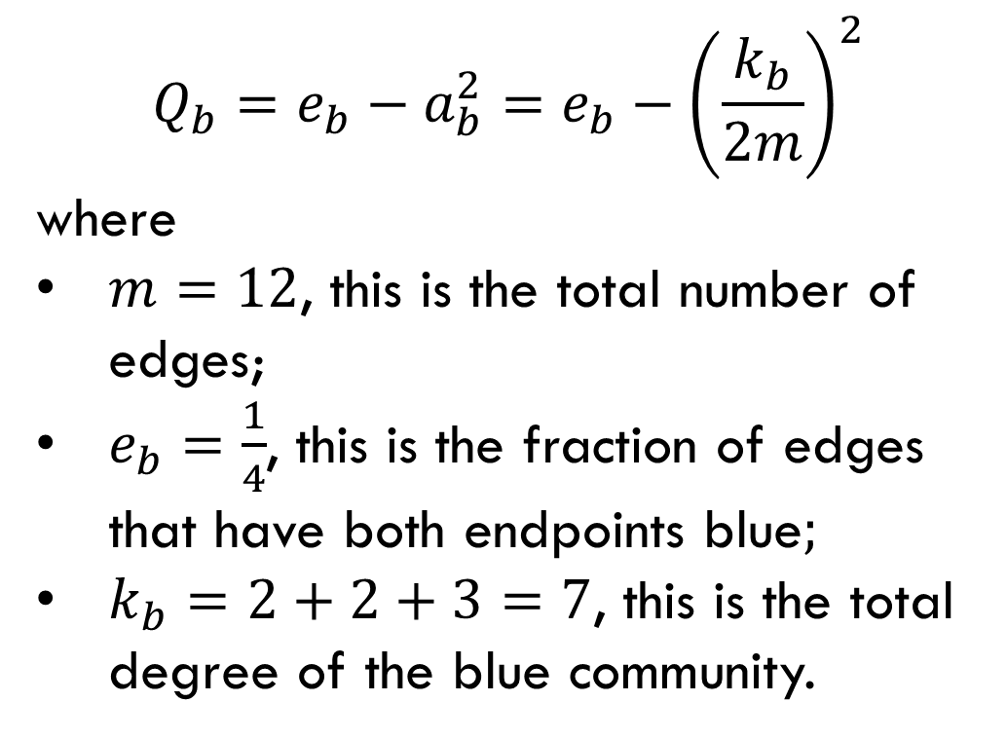
Calculation of $Q_{b}$
$$Q_{b}=e_{b}−a_{b}^{2}=e_{b}−{\left(\frac{k_{b}}{2m}\right)}^{2}$$
where
$m=12$, this is the total number of edges;
$e_{b}=\frac{1}{4}$, this is the fraction of edges that have both endpoints blue$;$
$k_{b}=2+2+3=7$, this is the total degree of the blue community.
$$Q_{b}=\frac{1}{4}−{\left(\frac{7}{24}\right)}^{2}≈0.1694$$

Slide 12


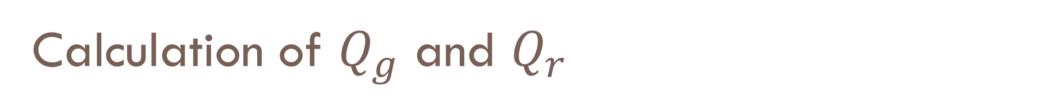
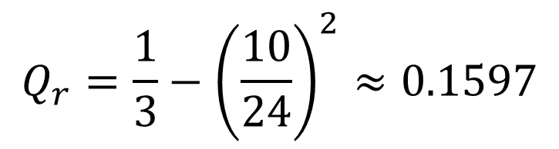
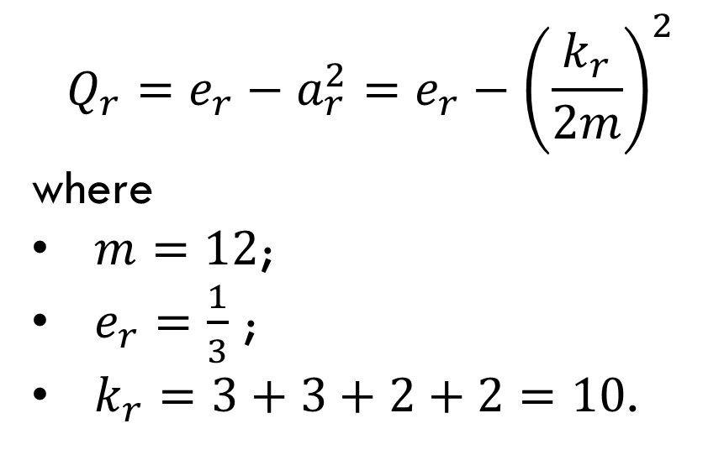
Calculation of $Q_{g}$ and $Q_{r}$
By symmetry, $Q_{g}=Q_{b}≈0.1649$.
The modularity of the red community:
$$Q_{r}=e_{r}−a_{r}^{2}=e_{r}−{\left(\frac{k_{r}}{2m}\right)}^{2}$$
where
$m=12$;
$e_{r}=\frac{1}{3}$ ;
$k_{r}=3+3+2+2=10$.
$$Q_{r}=\frac{1}{3}−{\left(\frac{10}{24}\right)}^{2}≈0.1597$$

Slide 13
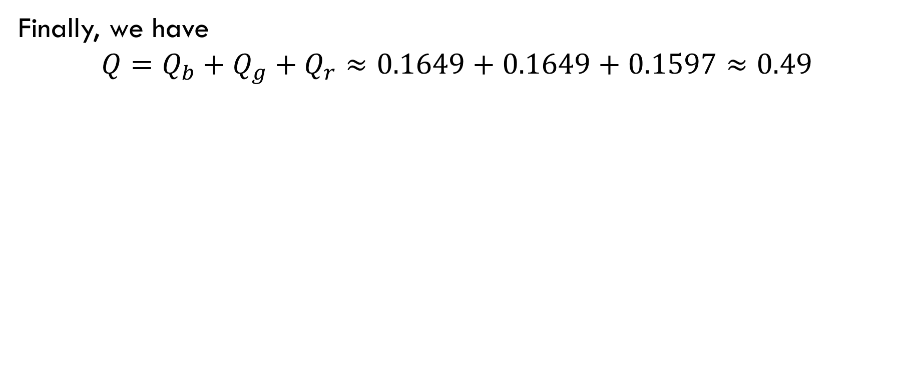
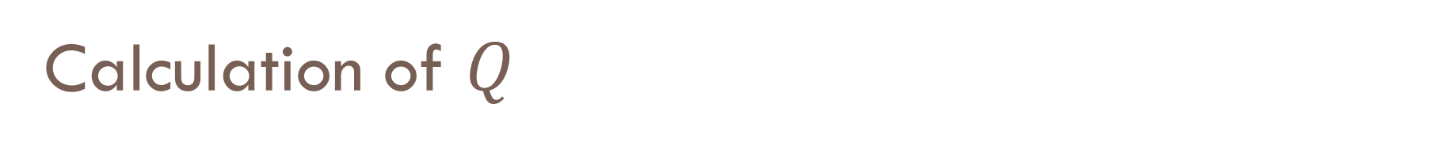
Calculation of $Q$
Finally, we have
$$Q=Q_{b}+Q_{g}+Q_{r}≈0.1649+0.1649+0.1597≈0.49$$

Slide 14
Exercise

Slide 15
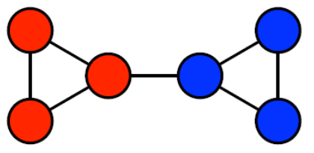
Exercise
Calculate the modularity of the colored graph on the right.

Slide 16
Calculating Modularity
Calculate the modularity of the colored graph on the right.
By definition of modularity,
$$Q_{r}=e_{r}−{\left(\frac{k_{r}}{2m}\right)}^{2}$$
the sum of the degrees of all vertices colored with red
$$=2+2+3=7$$
the fraction of edges having both endpoints colored with red $=3/7$
the total number of edges $=7$

Slide 17
Solution
Calculate the modularity of the colored graph on the right.
We have
$$Q_{r}=e_{r}−{\left(\frac{k_{r}}{2m}\right)}^{2}= \frac{3}{7}−{\left(\frac{7}{14}\right)}^{2}=\frac{5}{28}$$
Since $Q_{b}=Q_{r}$ by symmetry, we have
$Q=\frac{5}{28}+\frac{5}{28}≈0.357$

Slide 18
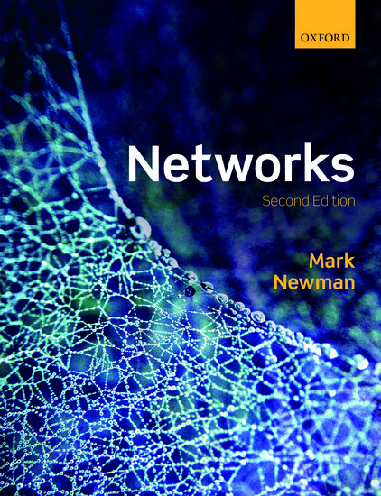
Reading
Section 7.7

